Slide 1
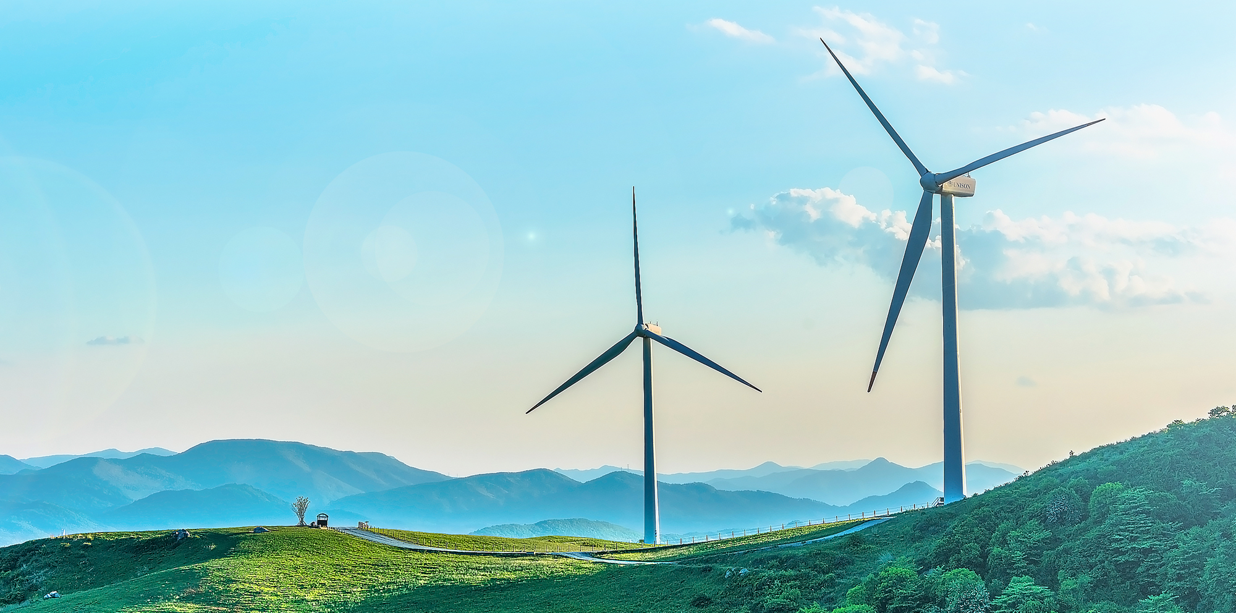





OnePagers and Land-use Sector
Onesmus Mwabonje
Paisan Sukpanit
Victoria Hoare
Jeremy Woods
2050 Calculator

Slide 2
8 step plan for 2050 KCERT success
Think about the drivers for sector
Draw up driver tree
Think about your draft 1 pager
Come up with your list of inputs
Think about your stakeholder workshop
What will your stakeholder say?
Excel workbook and webtool Development
What insights can we get out of this?

Slide 3
Driver tree: What are the drivers for international aviation in the UK?
Abiding principle. Don’t over complicate. If you can simplify, do.
Emissions factor (kg / kW h)
Efficiency (kW h / passenger-km)
UK population
Annual Emissions (kg CO₂e)
×
Fuel consumed (kW h)
×
Average number of flights / year
Total person-distance flown (passenger-km)
×
Distance flown per person
(passenger-km)
×
Key
Average distance per flight
(km)
= Output
= Inputs

Slide 4
Driver tree: What are the drivers for solar PV in Kenya?
Abiding principle. Don’t over complicate. If you can simplify, do.
Efficiency factor
(%)
Annual Electricity generated (TWh)
×
Average sunlight
(W sq m)
Number of roofs
Total solar panels installed (sq m)
×
Average roof area (sq metre)
Key
= Output
= Inputs

Slide 5
What does your 1-pager look like (write template)
Kenya has strong potential for solar projects and has already installed c15MW.
Level 1
Level 2
Level 3
Level 4

Slide 6
What is this missing out or what are the broad assumptions
Assumes normal PV, rather than Concentrating Solar Power (CSP). But you can change that quite easily by varying the efficiency factor
That normal PV does not become more efficient in the future – again this can be changed, so check with your stakeholders
We assume zero emissions from the sector because any production based emissions would either be included elsewhere or would be in another country

Slide 7
The inputs for the solar section of the KCERT 2050 Calculator
Focus on present day and 2050 to begin with. You can change the linear trajectory later.
Input | 2013 | 2020 | 2030 | 2040 | 2050 | Comments
Efficiency factor (%) | 20% | - | - | - | 20% | Unlikely that Kenya will be able to influence the international market. But could get better anyway
Sunlight conversion factor (W/ m sq) | 220 | - | - | - | 220 | Unlikely to get any sunnier
Installed capacity (MW) | 15 | - | - | - | ? | Yes – this seems like the key driver that can really be driven by ambition from government and the private sector

Slide 8
Who to invite for your stakeholder workshop, and what to ask them?
From government:
From NGOs:
From business:
From academia:

Slide 9
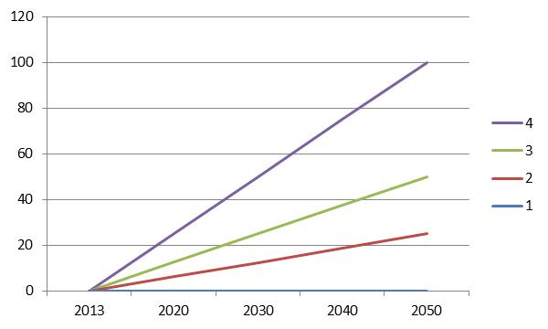
Example KCERT: one pager - Solar
Kenya has strong potential for solar projects (sun twice as powerful as in the UK). To date 15MW have been installed.
Level 1
Nothing more achieved other than the 15MW currently installed due to lack of government support and expensive PV panel prices.
Level 2
Current government ambition continues to 2050. Leading to 25GW installed capacity by 2050 providing 44 TWh per year. This would take up a land area of 113,000 sq km.
Level 3
Kenya doubles it’s current level of ambition, resulting in 50GW (88TWh per year).
Level 4
A huge effort is made, and 1.2m² per person of Kenya is dedicated to solar PV. This delivers 175 TWh per year of electricity, through 100 GW of installed capacity. The IEA estimate total global installed capacity by 2050 to be 3000GW.
For some context – what other countries have assumed……..
TWh per year
TWh per year

Slide 10
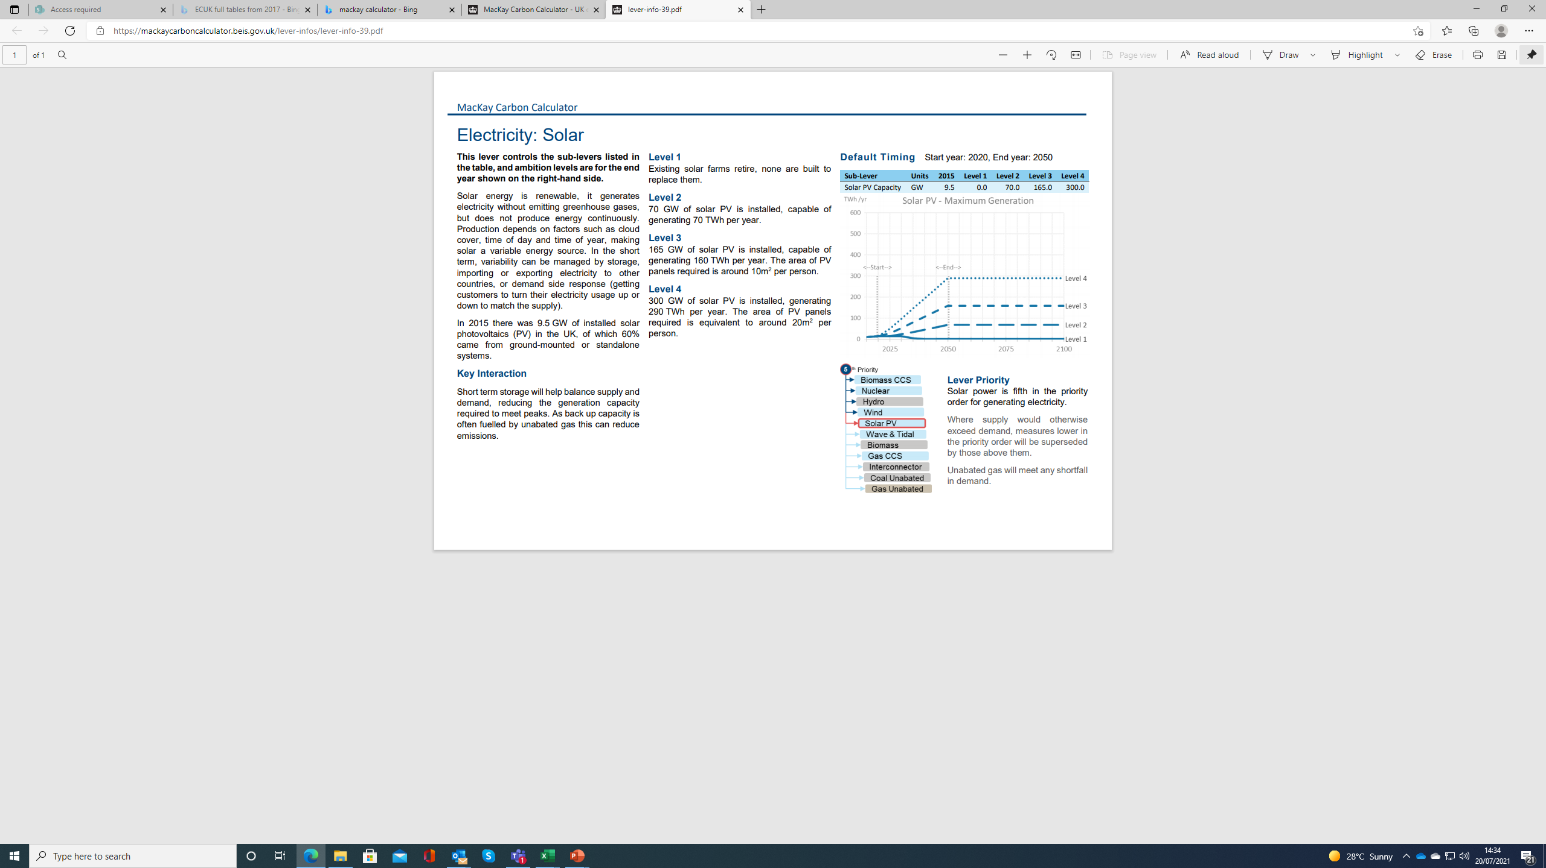
Example 1: one pager – Solar

Slide 11
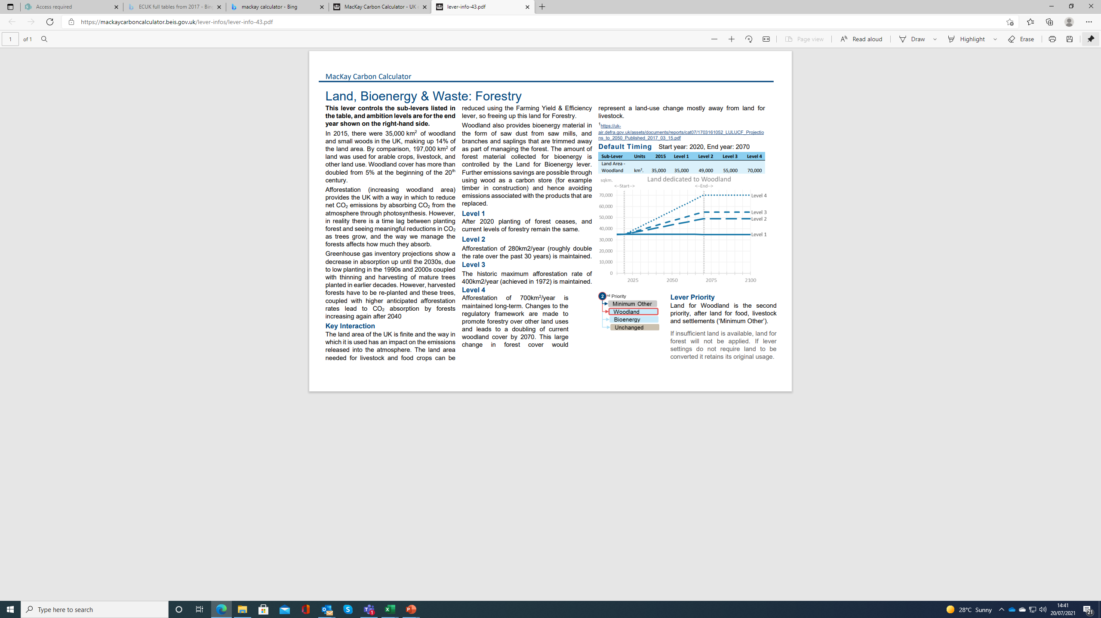
Example 2: One pager - Forestry

Slide 12
Deep dive into the land, bioenergy and waste sectors

Slide 13
Interlinkages
Buildings
Land
Forests
Bioenergy land
Arable land
Livestock grazing land
Electricity generation
Bioenergy resources
Solid biomass
Liquid biomass
Biogas
Industry
Heat generation
Waste
Dry waste
Wet waste
Used cooking oil
Biofuels
Transport

Slide 14
Levers in this sector
Lever | Description
Farming Yield & Efficiency | Reductions in the number of livestock, crop yield improvements and the emission intensity of agricultural processes
Forestry | Land dedicated to planting forest (requires land to be freed up using the Farming Yield & Efficiency lever)
Land for Bioenergy | Land dedicated to growing bio-crops (requires land to be freed up using the Farming Yield & Efficiency lever)
Waste Reduction | Amount of waste produced, recycled and diverted to energy processes

Slide 15
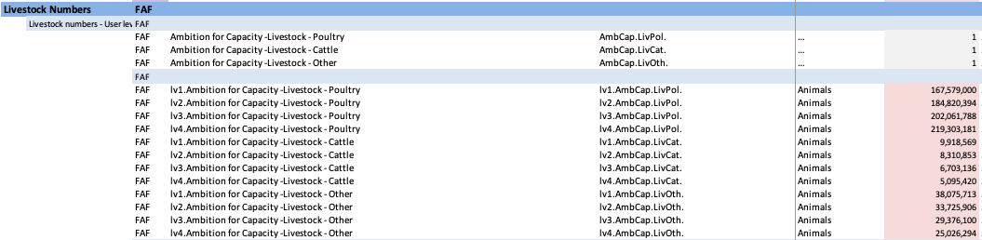
Livestock
Category | Bio resources | Greenhouse Gas Emission
Poultry | No | No
Cattle | Yes | Yes
Other | Yes | Yes

Slide 16
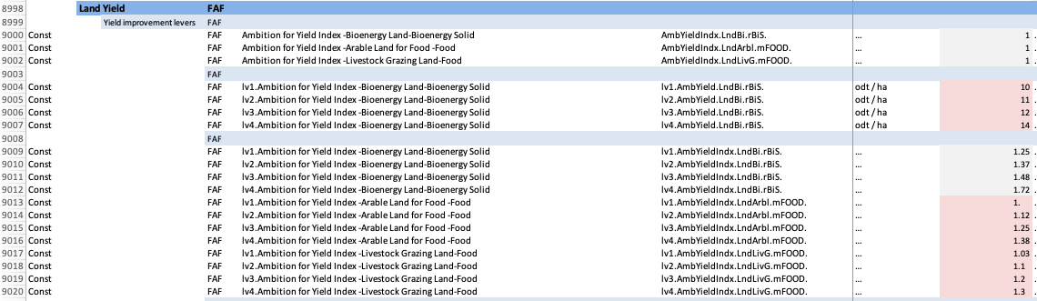
Land Yield

Slide 17
Land-Use Change Assumptions
Land Gain
Land Loss
UK assumptions to have fixed profile
Woodland
Livestock Grazing Land
Other Land
Bioenergy Land
Arable Land for Food
Settlements

Slide 18
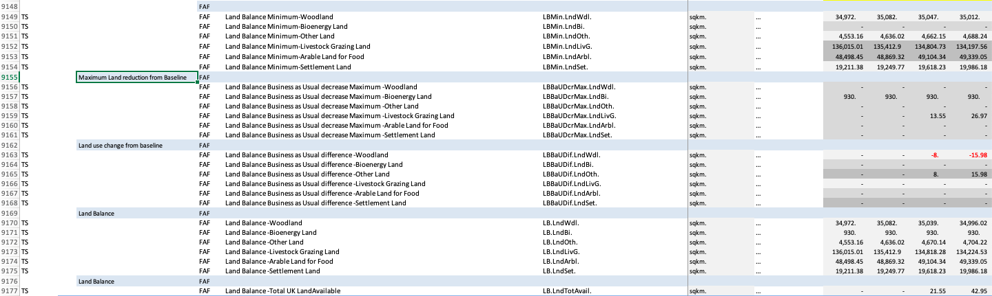
Calculation of land balance

Slide 19
Calculation logic of land balance
BaU Scenario for land-use
Deductible land
New Forests
Existing Forests
Final Forests
New Bioenergy land
Existing Bioenergy land
Final Bioenergy land
Final Livestock grazing land
Final Arable land for food

Slide 20
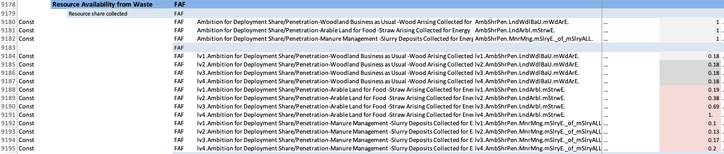
Bio Resource Availability

Slide 21
Calculation logic – Bio resources
Collected for Energy
Forests
Wood
Leftover waste (Not collected for energy)
Arable Land for Food
Straw
Livestock
Manure

Slide 22
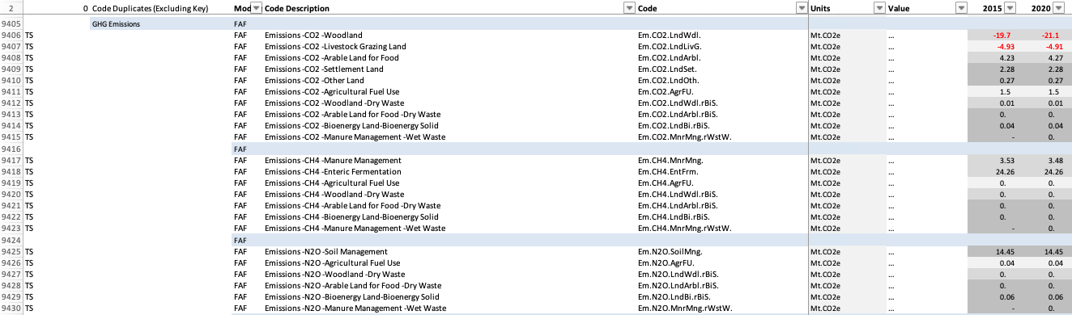
Emissions

Slide 23
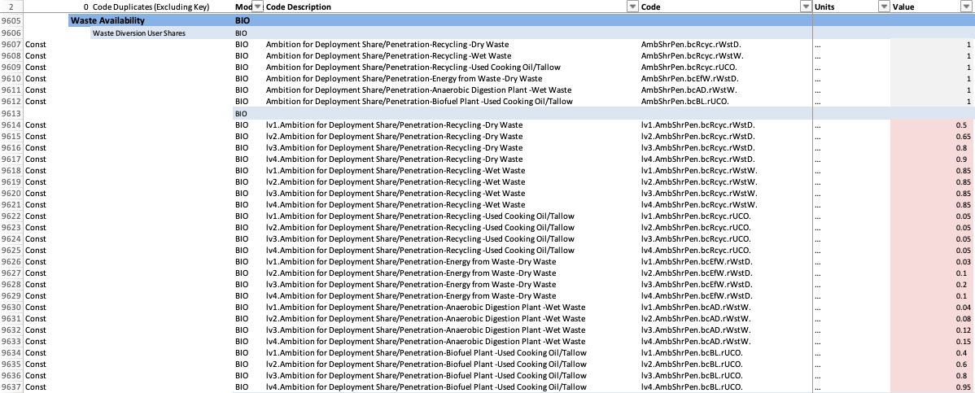
The Waste Sector

Slide 24
Calculation logic
Energy from Waste
Biogas released to the atmosphere
Waste
Landfill
Recycle
Biogas captured from landfill

Slide 25
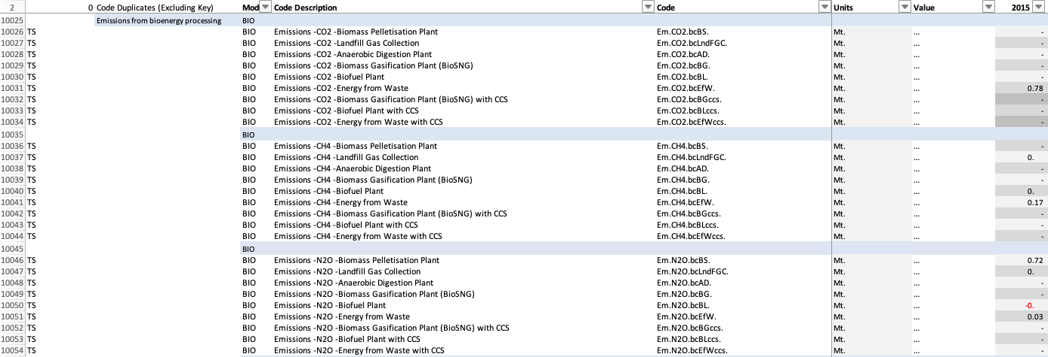
Emissions

Slide 26
Discussions
UK Land-use categories | Kenya
Forests
Bioenergy land
Arable land for food
Livestock grazing land
Settlements
Other land

Slide 27
Next steps
Team to familiarise with the spreadsheet model
Start considering and gathering data for each sector (Data tracker)
Continue identifying and mapping key sector stakeholders
Planning for co-design and expert sector workshops
Continue with deep-dive on sector logic trees (Transport and Industry sectors)
Start to think about One pagers development

Slide 28






